Slide 1
Gesture Recognition for Sign language
Akarsh K., Zenith S., Sandeep R., Neha S.

Slide 2
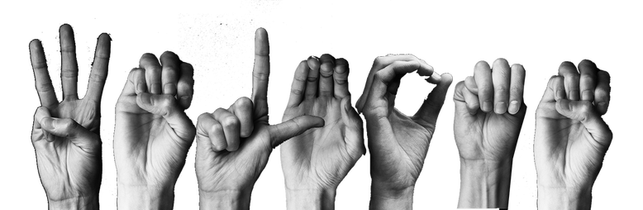
Problem Statement
250 interpreters
~ 2-7 million deaf Indians
Source: ://www.pri.org/stories/2017-01-04/deaf-Community-millions-hearing-india-only-just-beginning-sign
01
To develop a Gesture Recognition system that can understand and classify sign language gestures, to simplify the lives of the deaf and dumb.

Slide 3





Advantages
Gesture Recognition
With the lack of resources for translation and interpretation of sign language, an easy-to-use tool like this can be deployed in web-apps to support the disabled; in learning platform / classrooms, or as a translation device.
Teaching Sign language
Active translator
Real-time functioning
User defined data

Slide 4
Future Scope
01
Can be developed into a system which will Dynamically take input ( Gesture and Gesture names ) so that trained translators can improve the dataset.
02
Dynamic inputs will allow users of different countries to add their Country specific sign-language gestures.
03
Can be developed into a Text-to-Voice system, that will understand a deaf person’s gesture, print the name of the gesture on the screen, and speak out the Gesture name, using NLP or Google API.

Slide 5
Conclusion
This project enabled us to work on different Artificial intelligence concepts, such as Computer vision (using OpenCV) and Video processing using CNN concepts.
This project has great scope for scalability and application in various fields such as Mobile app development, Translator devices and remote access teaching and translation.

Slide 6
Thank you

